Slide 1

Employee Productivity & Well-being Tracker
A Data-Driven Approach to Balancing Performance & Employee Health

Slide 2

Introduction

Slide 3
INTRODUCTION
COMPANIES STRUGGLE TO MAINTAIN A BALANCE BETWEEN EMPLOYEE PRODUCTIVITY AND WELL-BEING.
OVERWORKING CAN LEAD TO BURNOUT, WHILE UNDERPERFORMANCE AFFECTS COMPANY GROWTH.
THIS PROJECT AIMS TO CREATE A POWER BI DASHBOARD TO ANALYZE PRODUCTIVITY AND WELL-BEING TRENDS.

Slide 4

Define the Problem

Slide 5
PROBLEM STATEMENT
EMPLOYEES OFTEN EXPERIENCE STRESS DUE TO WORKLOAD IMBALANCE, LEADING TO BURNOUT AND HIGH ATTRITION RATES.
LACK OF REAL-TIME MONITORING MAKES IT DIFFICULT FOR MANAGERS TO IDENTIFY STRUGGLING EMPLOYEES.
BUSINESSES NEED A SOLUTION TO TRACK AND IMPROVE BOTH PRODUCTIVITY AND EMPLOYEE SATISFACTION.

Slide 6
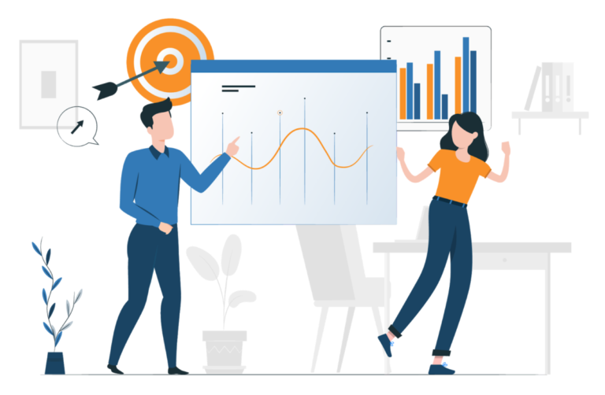
Objectives

Slide 7
MAIN GOALS
TRACK EMPLOYEE PRODUCTIVITY USING KEY PERFORMANCE METRICS.
IDENTIFY POTENTIAL BURNOUT RISKS AND SUGGEST PREVENTIVE ACTIONS.
PROVIDE MANAGERS WITH REAL-TIME, DATA-DRIVEN INSIGHTS.
FOSTER A HEALTHIER WORK ENVIRONMENT THAT IMPROVES BOTH EFFICIENCY AND WELL-BEING.

Slide 8

Dataset Overview

Slide 9
KEY FIELDS IN THE DATASET
EMPLOYEE DETAILS: EMPLOYEE_ID, DEPARTMENT, JOB_TITLE, GENDER, AGE, EDUCATION_LEVEL, HIRE_DATE, YEARS_AT_COMPANY.
PRODUCTIVITY METRICS: PERFORMANCE_SCORE, WORK_HOURS_PER_WEEK, PROJECTS_HANDLED, OVERTIME_HOURS.
WELL-BEING INDICATORS: SICK_DAYS, REMOTE_WORK_FREQUENCY, EMPLOYEE_SATISFACTION_SCORE.
CAREER GROWTH FACTORS: TRAINING_HOURS, PROMOTIONS, TEAM_SIZE.
RESIGNATION STATUS: BOOLEAN VALUE INDICATING IF THE EMPLOYEE HAS RESIGNED.

Slide 10

Proposed Solution
(Power BI Dashboard)

Slide 11
KEY FEATURES OF THE DASHBOARD
INTERACTIVE CHARTS & GRAPHS DISPLAYING EMPLOYEE PERFORMANCE TRENDS.
AI-DRIVEN INSIGHTS TO DETECT WORKLOAD IMBALANCES AND STRESS INDICATORS.
ALERTS & NOTIFICATIONS FOR POTENTIAL BURNOUT RISKS.
COMPARISONS BETWEEN TEAMS/DEPARTMENTS TO OPTIMIZE RESOURCE ALLOCATION.

Slide 12

Expected Outcomes

Slide 13
IMPACT ON EMPLOYEES & MANAGEMENT
IMPROVED EMPLOYEE ENGAGEMENT AND SATISFACTION LEVELS.
ENHANCED PERFORMANCE MONITORING WITH REAL-TIME INSIGHTS.
REDUCTION IN BURNOUT CASES, LEADING TO BETTER RETENTION RATES.
DATA-DRIVEN DECISION-MAKING FOR HR POLICIES & WORKLOAD DISTRIBUTION.

Slide 14

Conclusion

Slide 15
CONCLUSION
THIS PROJECT WILL HELP BUSINESSES CREATE A BALANCE BETWEEN PRODUCTIVITY AND WELL-BEING.
A WELL-STRUCTURED POWER BI DASHBOARD WILL ASSIST HR AND MANAGEMENT IN MAKING INFORMED DECISIONS.

Slide 16
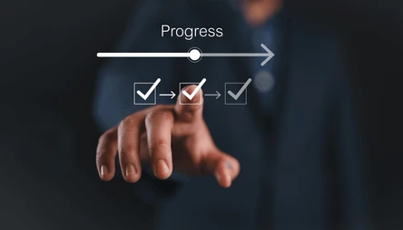
Next Steps

Slide 17
NEXT STEPS
COLLECT SAMPLE DATA OR REAL-TIME DATA FROM COMPANY TOOLS.
ACQUIRE RELEVANT DATASETS FROM KAGGLE FOR ADDITIONAL INSIGHTS.
DESIGN THE POWER BI DASHBOARD LAYOUT.
IMPLEMENT AND TEST DATA VISUALIZATION TECHNIQUES.
IMPLEMENT MACHINE LEARNING MODEL(CLASSIFICATION MODEL LIKE RANDOM FOREST

Slide 18

Thank you

